Slide 1

Shedding the light on reading

Slide 2
The Importance of the Four Language Cueing Systems
1. graphophonics = letters and their sounds
2. syntax = grammar and sentence structure
3. pragmatic = how words are used in familiar situations applied to similar situation described in new text
4. semantics = meaning of words
We need to use ALL of these in order to understand what we read!
From “What’s Your Cue? Incorporating the Semantic and Graphophonic Cueing Systems into Students’ Reading” Brandi R.P. Thacker

Slide 3

How do we help our students to put the pieces together??

Slide 4

By teaching them 4 steps to success!!

Slide 5
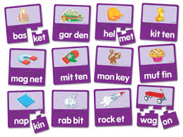
Next time your child comes to a tricky word, use these 4 steps to success to help them figure it out.
It’s so much more than just “sounding it out”.

Slide 6
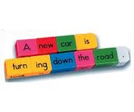
Step 1: Read around the word by reading the entire sentence. From “What’s Your Cue? Incorporating the Semantic and Graphophonic Cueing Systems into Students’ Reading” Brandi R.P. Thacker

Slide 7
This helps us to use the SYNTAX, SEMANTIC and PRAGMATIC cueing systems to help figure out the word. The most important thing to ask is “what word MAKES SENSE in this sentence?”
From “What’s Your Cue? Incorporating the Semantic and Graphophonic Cueing Systems into Students’ Reading” Brandi R.P. Thacker

Slide 8
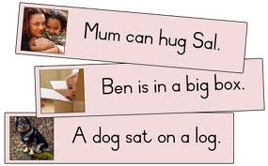
Step 2: Look at the pictures for clues. From “What’s Your Cue? Incorporating the Semantic and Graphophonic Cueing Systems into Students’ Reading” Brandi R.P. Thacker

Slide 9

Step 3: Make a guess. Think of a word that makes sense in this sentence and fits the picture. List some guesses on a post-it. From “What’s Your Cue? Incorporating the Semantic and Graphophonic Cueing Systems into Students’ Reading” Brandi R.P. Thacker

Slide 10
Step 4: Check your guess. Cross-check your words with the letters and length of the word you’re trying to figure out. Do you have a word that matches? From “What’s Your Cue? Incorporating the Semantic and Graphophonic Cueing Systems into Students’ Reading” Brandi R.P. Thacker

Slide 11
This helps us to use the GRAPHOPHONIC cueing system to match the words with the same letters and sounds.
From “What’s Your Cue? Incorporating the Semantic and Graphophonic Cueing Systems into Students’ Reading” Brandi R.P. Thacker

Slide 12

No more frustration!!
BEFORE
AFTER

Slide 13
Further Resources:
http://www.edu.gov.on.ca/eng/literacynumeracy/parentGuideLit2012.pdf
http://www.edu.gov.on.ca/abc123/eng/tips/readkto3.html
http://www2.ed.gov/parents/read/resources/edpicks.jhtml
http://www.readingrockets.org/audience/parents
Also, students are often more engaged by technology. Let them read articles on the internet of interest to them, or video game manuals, or play reading games on the computer. There are many ways we can help our students to enjoy reading while getting better at it. Please visit my website for links to some other sites of interest (mrsmclean.ca).

